Slide 1
Machine Learning Algorithms (III-II-II)
Master´s in Applied Artificial Intelligence
Luís Ferreira
lufer@ipca.pt

Slide 2
Overview
Part I
Artificial Intelligence and Machine Learning
Foundations
Part II
Machine Learning
Part III
Machine Learning Algorithms (I)
Parte IV
Machine Learning Algorithms (Adv.)

Slide 3
Part III
Machine Learning Algorithms
Competencies to be acquired:
Feature Engineering
  Scaling

Slide 4
Part III: MLA
Features Engineering
Features Engineering (review)
  Pre-Processing (handling: null values, duplicates, imbalanced dataset, outliers, etc.)
  Categories encoding (Data, Label and Ordinal Encoding)
  Categories dimensioning
  Generation and Extraction of categories
  Selecting relevant categories

Slide 5
Part III: MLA
Features Engineering
Feature Scaling
  Dealing with datasets containing features that have different ranges, units of measurement, or orders of magnitude.
  Dataset’s features can be transformed to a more consistent scale, making it easier to build accurate and effective machine learning models.
See: https://www.yourdatateacher.com/2021/03/22/scaling-of-the-numerical-variables/

Slide 6
Part III: MLA
Features Engineering
Why Feature Scaling:
  Equalizes Feature Contributions
  Improves Model Convergence (Gradient Descent)
  Enhances Distance-Based Algorithms (K-Means and Support Vector Machines )
  Regularization (L1 and L2 regularization)

Slide 7
Part III: MLA
Features Engineering
Why Feature Scaling:
  Equalizes Feature Contributions
  Improves Model Convergence (Gradient Descent)
  Enhances Distance-Based Algorithms (K-Means and Support Vector Machines )
  Regularization (L1 and L2 regularization)
Different Units: Area is in square meters, and price is in euros. These have vastly different scales.
Dominant Features: If not scaled, the price feature might dominate the model's decisions, as it has a much larger range of values.
Notes:
Houses

Slide 8
Part III: MLA
Features Engineering
When to use Feature Scaling:
  Distance-Based Algorithms: K-Means, K-Nearest Neighbors, Support Vector Machines
  Gradient Descent-Based Algorithms: Linear Regression, Logistic Regression, Neural Networks
  Regularization Techniques: L1 and L2 regularization

Slide 9
Part III: MLA
Features Engineering
Feature Scaling techniques:
  Standardization (Z-score normalization or Standard scaling)
  Normalization (Min-Max Scaling)

Slide 10

Part III: MLA
Features Engineering
$$z={\left(x−μ\right)}/σ$$
Z is the standardized score (also called a z-score)
x is the original value you want to standardize
μ (mu) is the mean of the data set
σ (sigma) is the standard deviation of the data set
Feature Scaling: Standardization
  Each feature is transformed to have a mean of 0 and a standard deviation of 1. This is achieved by subtracting the ( ) mean value and dividing by the ( ) standard deviation of the feature
  Note: Applied standardization to numerical columns, not to the other One-Hot Encoded (they are already between 0 and 1)!

Slide 11

Part III: MLA
Features Engineering
Feature Scaling: Standardization
  Each feature is transformed to have a mean of 0 and a standard deviation of 1. This is achieved by subtracting the ( ) mean value and dividing by the ( ) standard deviation of the feature
$$z={\left(x−μ\right)}/σ$$

Slide 12
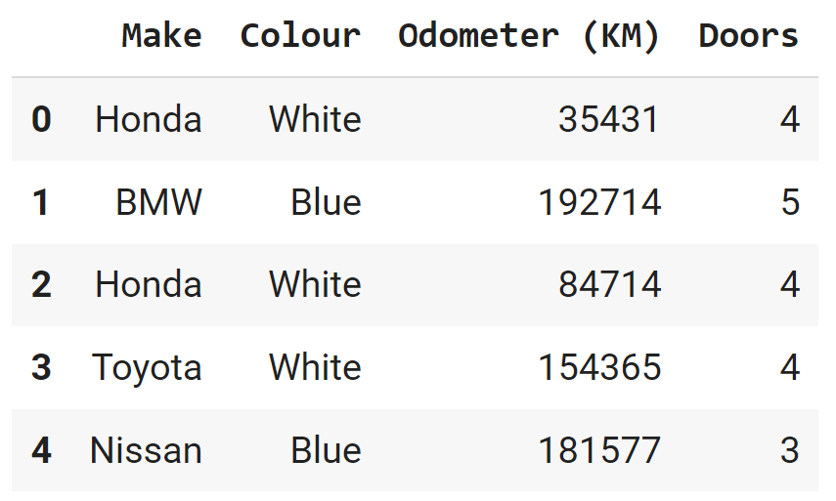

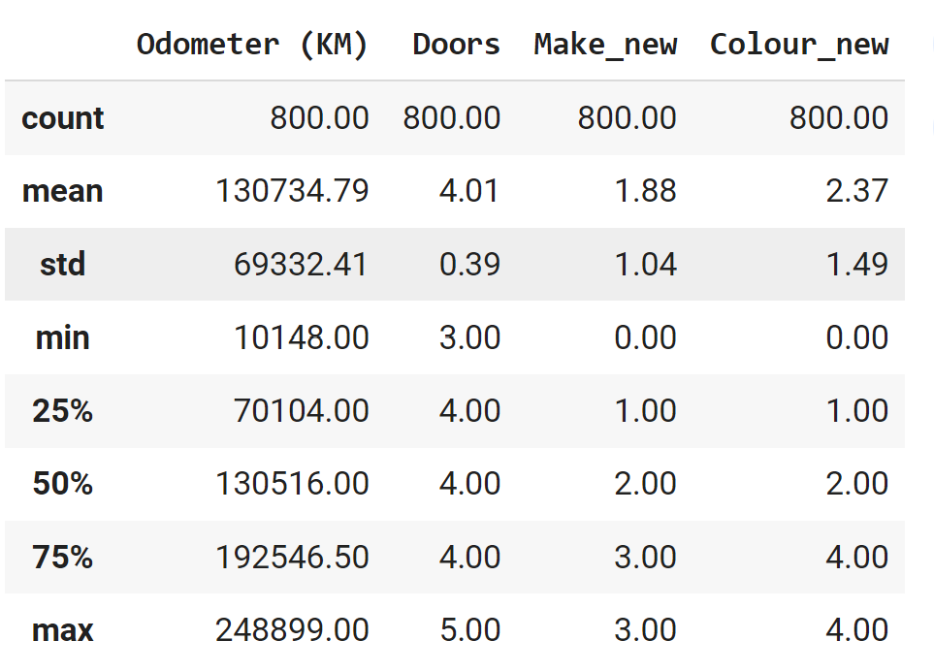
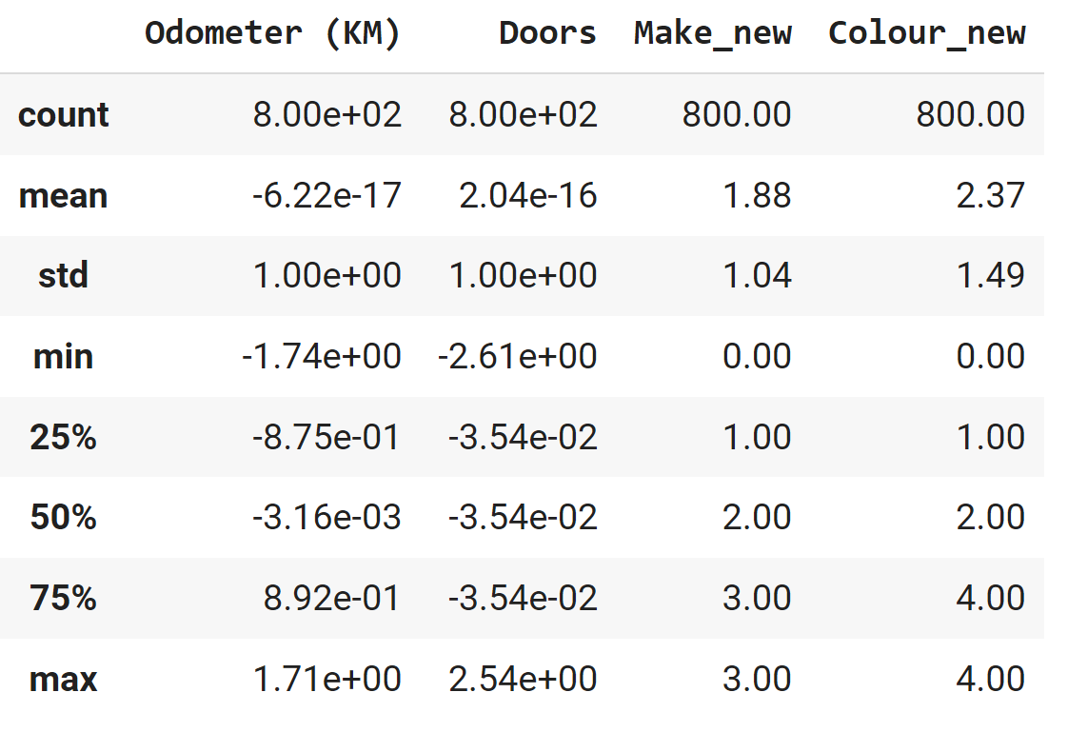
Part III: MLA
Features Engineering
Feature Scaling: Standardization
  Each feature is transformed to have a mean of 0 and a standard deviation of 1. This is achieved by subtracting the ( ) mean value and dividing by the ( ) standard deviation of the feature

Slide 13
Part III: MLA
Features Engineering
Feature Scaling: Standardization
  Each feature is transformed to have a mean of 0 and a standard deviation of 1. This is achieved by subtracting the ( ) mean value and dividing by the ( ) standard deviation of the feature
from sklearn.preprocessing import StandardScaler
#Create a StandardScaler objectscaler
scaler = StandardScaler()
# Fit the scaler to the data and transform it
scaled_data = scaler.fit_transform(df)
# Convert the scaled data back to a DataFrame
scaled_df = pd.DataFrame(scaled_data, columns=df.columns)

Slide 14
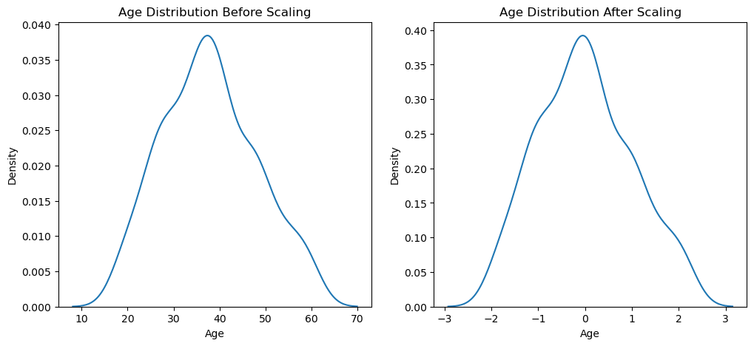
Part III: MLA
Features Engineering
Feature Scaling: Standardization
  Each feature is transformed to have a mean of 0 and a standard deviation of 1. This is achieved by subtracting the ( ) mean value and dividing by the ( ) standard deviation of the feature
from sklearn.preprocessing import StandardScaler
#Create a StandardScaler objectscaler
StandardScaler()
# Fit the scaler to the data and transform it
scaled_data = scaler.fit_transform(df)
# Convert the scaled data back to a DataFrame
scaled_df = pd.DataFrame(scaled_data, columns=df.columns)

Slide 15
Part III: MLA
Features Engineering
$${\left(x−\min\left(x\right)\right)}/{\left(\max\left(x\right)−\min\left(x\right)\right)}$$
x is the value you want to normalize
min(x) is the minimum value in your data set
max(x) is the maximum value in your data set
Feature Scaling: Normalization
  Scales each feature so that all values are within the range of 0 and 1. It achieves this by subtracting the minimum value of the feature and dividing by the range (difference between maximum and minimum values)
  Normalization == Min-Max-Scaling
  Towards a Normal Distribution (Gaussian distribution == Bell Curve)

Slide 16
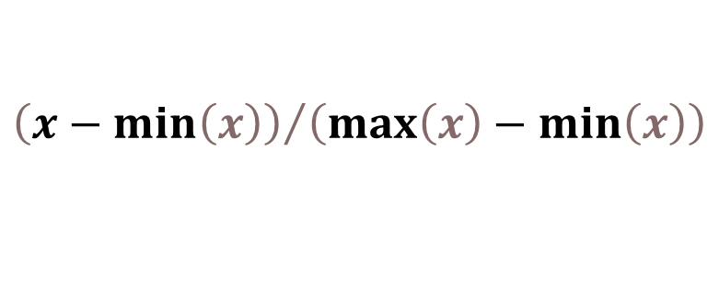
Part III: MLA
Features Engineering
$${\left(x−\min\left(x\right)\right)}/{\left(\max\left(x\right)−\min\left(x\right)\right)}$$
x is the value you want to normalize
min(X) is the minimum value in your data set
max(X) is the maximum value in your data set
Feature Scaling: Normalization
  Scales each feature so that all values are within the range of 0 and 1. It achieves this by subtracting the minimum value of the feature and dividing by the range (difference between maximum and minimum values)
$${\left(x−\min\left(x\right)\right)}/{\left(\max\left(x\right)−\min\left(x\right)\right)}$$

Slide 17

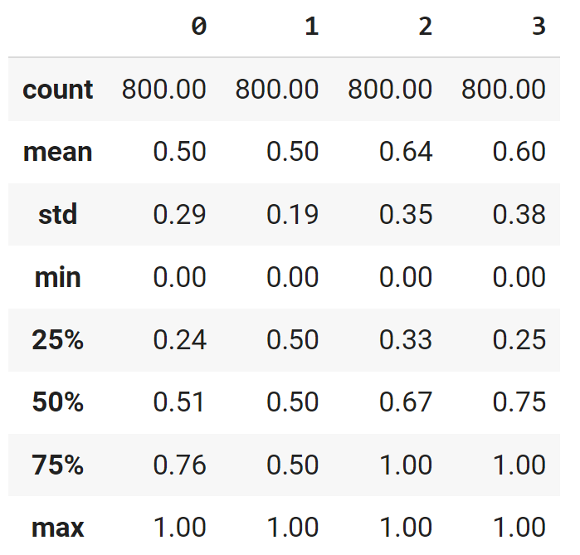
Part III: MLA
Features Engineering
Feature Scaling: Normalization
  Is a data preprocessing technique employed to standardize the values of features in a dataset, bringing them to a common scale.
  This process enhances data analysis and modelling accuracy by mitigating the influence of varying scales on machine learning models.
  Values are shifted and rescaled so that they end up ranging between 0 and 1

Slide 18
Part III: MLA
Features Engineering
from sklearn.preprocessing import MinMaxScaler
# Create a MinMaxScaler object
scaler = MinMaxScaler()
# Fit the scaler to the data and transform it
scaled_data = scaler.fit_transform(df)
# Convert the scaled data back to a DataFrame
scaled_df = pd.DataFrame(scaled_data, columns=df.columns)
Feature Scaling: Normalization
  Is a data preprocessing technique employed to standardize the values of features in a dataset, bringing them to a common scale.
  This process enhances data analysis and modelling accuracy by mitigating the influence of varying scales on machine learning models.
  Values are shifted and rescaled so that they end up ranging between 0 and 1

Slide 19
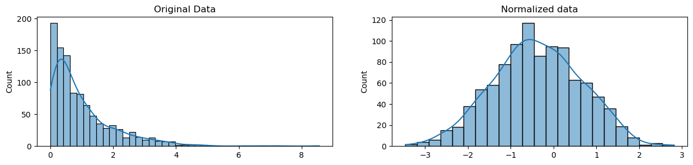
Part III: MLA
Features Engineering
from sklearn.preprocessing import MinMaxScaler
# Create a MinMaxScaler object
scaler = MinMaxScaler()
# Fit the scaler to the data and transform it
scaled_data = scaler.fit_transform(df)
# Convert the scaled data back to a DataFrame
scaled_df = pd.DataFrame(scaled_data, columns=df.columns)
Feature Scaling: Normalization
  Is a data preprocessing technique employed to standardize the values of features in a dataset, bringing them to a common scale.
  This process enhances data analysis and modelling accuracy by mitigating the influence of varying scales on machine learning models.
  Values are shifted and rescaled so that they end up ranging between 0 and 1

Slide 20
Part III: MLA
Features Engineering
Feature Scaling: What happens with the original values? Recovering it…
For Min-Max Normalization:
  𝑥 = 𝑥_{norm} × (max−min) + min
For Z-Score Normalization:
  𝑥 = 𝑧 × 𝜎 +𝜇

Slide 21
Part III: MLA
Features Engineering
Feature Scaling: Practice Lab
  4_Features Scaling.ipynb
Notes:
https://statplace.com.br/blog/coeficientes-de-correlacao/

Slide 22
Progress
Part I
Artificial Intelligence and Machine Learning
Foundations
Part II
Machine Learning
Part III
Machine Learning Algorithms (I)
Part IV
Machine Learning Algorithms (I)
Part V
Deep Learning & Neural Networks

Slide 23
References
Feature Scaling - why is it required? by Rahul Saini
Feature Scaling with Scikit-Learn by Ben Alex Keen
Feature Scaling for Machine Learning: Understanding the Difference Between Normalization vs. Standardization by Aniruddha Bhandari

Slide 24
References
Pandas Data Preprocessing — Data Binning
Feature Scaling: Engineering, Normalization, and Standardization
  https://www.analyticsvidhya.com/blog/2020/04/feature-scaling-machine-learning-normalization-standardization/
Complete Guide to Feature Engineering: Zero to Hero
  https://www.analyticsvidhya.com/blog/2021/09/complete-guide-to-feature-engineering-zero-to-hero/

Slide 25
References
The Lifecycle of an AI
  https://labelyourdata.com/articles/lifecycle-of-an-ai-project-stages-breakdown#step_4_scrub_your_data_clean
Examples of Machine Learning Projects
  https://www.datacamp.com/blog/machine-learning-projects-for-all-levels
Elements of AI (free online course)
  https://www.elementsofai.com/

Slide 26
References
Google Colab
  https://colab.research.google.com/
Pandas Tutorial
  https://www.w3schools.com/python/pandas/ref_df_sample.asp

Slide 27
References
Machine Learning. Tom M. Mitchel, McGraw-Hill, 1997
Machine Learning for Everyone
  https://vas3k.com/blog/machine_learning/
Machine Learning Tutorial
  https://www.simplilearn.com/tutorials/machine-learning-tutorial/machine-learning-steps
What is machine learning and how does it work? In-depth guide
  https://www.techtarget.com/searchenterpriseai/definition/machine-learning-ML

Slide 28
Appendices

Slide 29
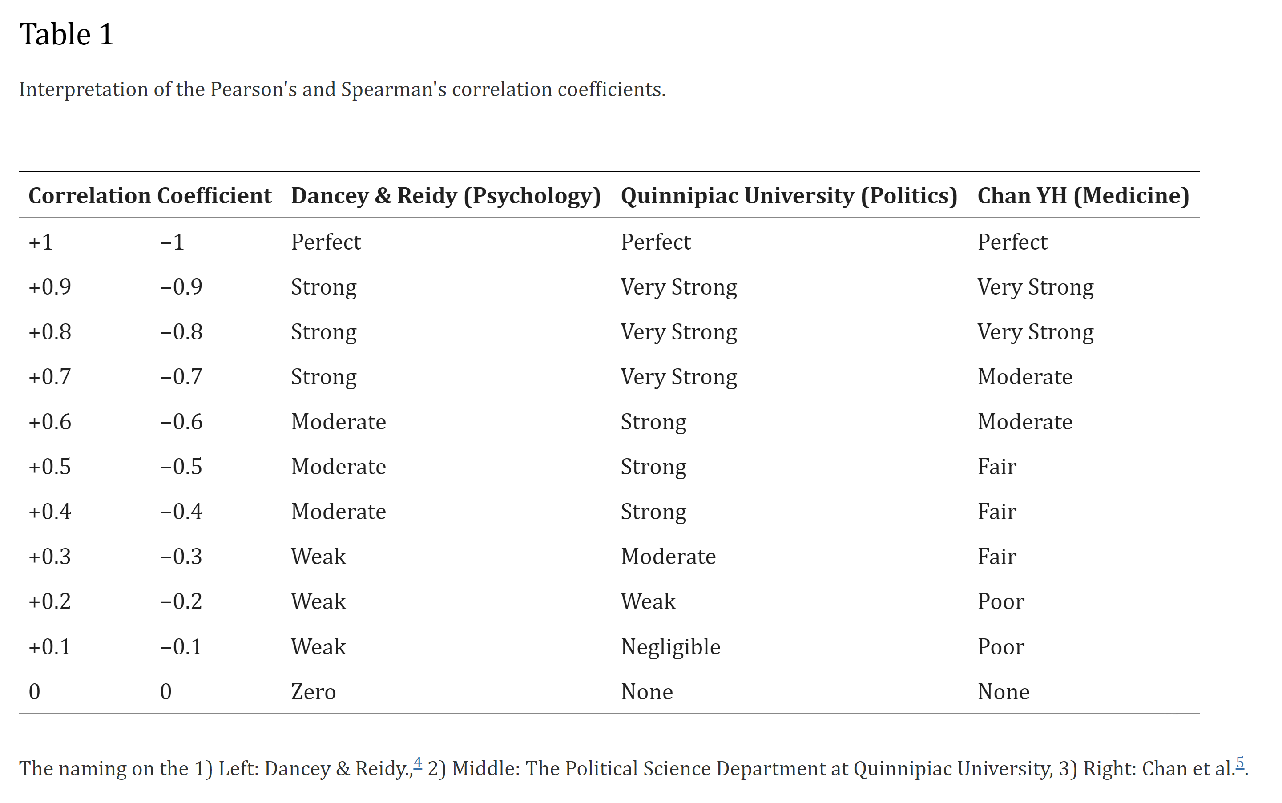
Notes:
https://vas3k.com/blog/machine_learning/

Slide 30
Normalization | Standardization
Rescales values to a range between 0 and 1 | Centers data around the mean and scales to a standard deviation of 1
Useful when the distribution of the data is unknown or not Gaussian | Useful when the distribution of the data is Gaussian or unknown
Sensitive to outliers | Less sensitive to outliers
Retains the shape of the original distribution | Changes the shape of the original distribution
May not preserve the relationships between the data points | Preserves the relationships between the data points
Equation: (x – min)/(max – min) | Equation: (x – mean)/standard deviation
https://www.analyticsvidhya.com/blog/2020/04/feature-scaling-machine-learning-normalization-standardization/
Notes:
https://vas3k.com/blog/machine_learning/

